Slide 1

02 March 2021

Slide 2
Agenda
Introduction to lecturer and subject
What are Data structures?
Arrays
One-dimensional Array processing
Class exercises
Homework
Conclusion

Slide 3

Introduction to ADF260/1/2S
Who are the lecturers?
Radford Burger –

Slide 4
Introduction to ADF260/1/2S
Who are the other lecturers?
Zukile Ndyalivana
Arinze Anikwue

Slide 5
Introduction to ADF2
Learner guide and Blackboard
Theory and practical classes (online)
Etiquette – also known as ‘consideration for others’

Slide 6
Introduction to ADF2
Learning Resources: recommended reading
Problem Solving in Data Structures and Algorithms Using Java: by Hemant Jain
Data Structures and Algorithms : by Michael T. Goodrich and Roberto Tamassia
Data Structures and Problem Solving Using Java: by Mark Allen Weiss
Data Structures and Algorithms Made Easy in Java: by Narasimha Karumanchi

Slide 7
Introduction to ADF2
Learning Resources: recommended websites
https://www.tutorialspoint.com/video_tutorials/data_structures_and_algorithms/DS-T
https://w3resource.com/
https://Topcoder.com/
https://geeksforgeeks.org
Youtube videos
https://www.youtube.com/playlist?list=PLsyeobzWxl7oRKwDi7wjrANsbhTX0IK0J

Slide 8
Introduction to ADF2
Assessments
Term 1 weighting = 10%
Small assignments
Completed during the term
Bigger assignment
Completed during the recess

Slide 9
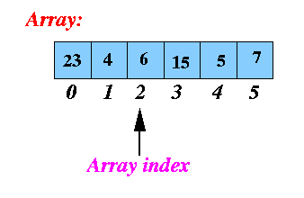
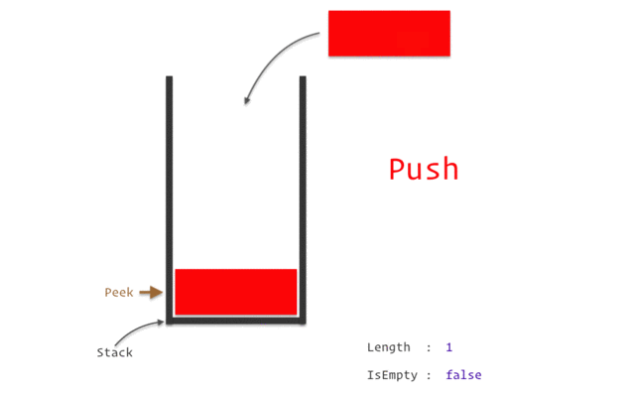
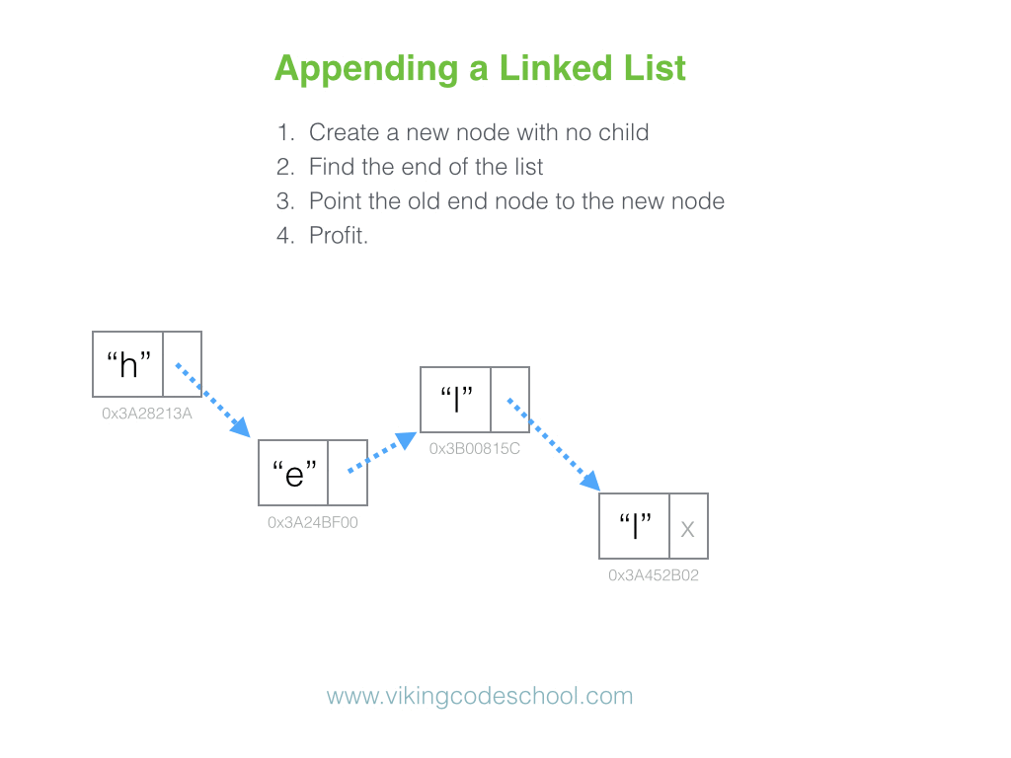
What are Data structures?
Arrays
Stacks
Trees
Linked Lists
Graphs
Queues

Slide 10
What are Data structures?
structural organization of information or data
defines the way data is arranged in computer memory
All data structures have their own pros and cons
Depending upon the type of problem, we pick a data structure that is best suited for it

Slide 11
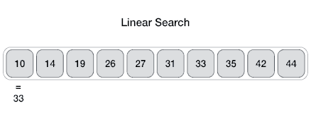
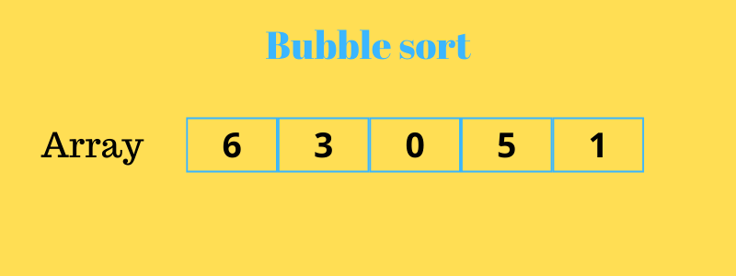
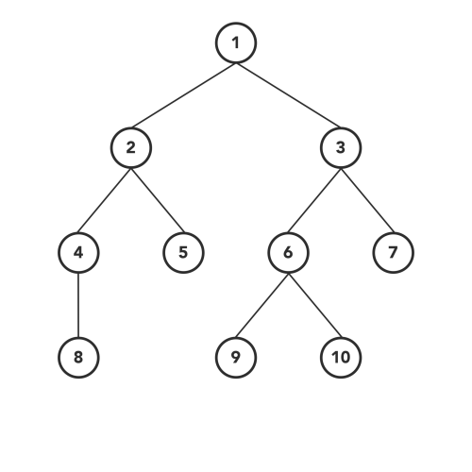
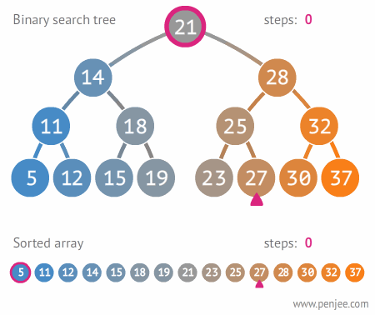
Algorithms
Tree traversal

Slide 12
What are Algorithms?
different operations performed on the information
a set of steps to accomplish a task
should be efficient in solving problems
Efficiency is measured in two parameters:
  Time-Complexity
  Space-Complexity
One data structure may support fast algorithms for some operations and slow execution for others

Slide 13
Arrays
Arrays are the most basic data structures used to store information.
An array is a data structure used to store multiple data elements of the same data type.

Slide 14

Arrays
Items are stored at contiguous memory locations
The value stored at any index can be accessed in constant time.
Memory locations

Slide 15
Arrays
int [ ] score = new int [5];
score[0] = 12;
score[1] = 6;
score[2] = 9;
score[3] = 11;
score[4] = 7;
Fixed length
Add/insert values
Memory location
311 | 312 | 313 | 314 | 315
Score
12 | 6 | 9 | 11 | 7
Index
0 | 1 | 2 | 3 | 4

Slide 16
Arrays: add more values
int [ ] score = new int [5];
score[5] = 8;
ArrayIndexOutOfBoundsException
Memory location
311 | 312 | 313 | 314 | 315
Score
12 | 6 | 9 | 11 | 7
Index
0 | 1 | 2 | 3 | 4

Slide 17
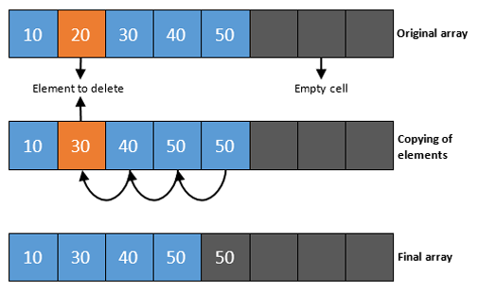
Arrays: remove values
removing or deleting an item doesn’t reduce the size of the array

Slide 18
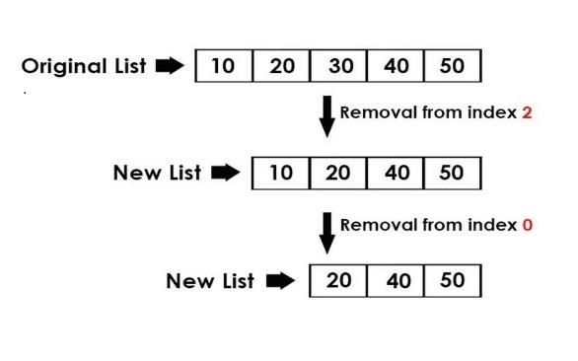
Arrays: remove values (alternative)
Find item to be removed then copy remaining items to new array

Slide 19
Arrays: print values
We use a loop and reference each element via the index.
int [ ] score = new int [5];
for (int i=0; i<score.length; i++) {
System.out.println(score[ i ]) ;
}

Slide 20
Arrays: advantages
Elements stored in contiguous memory locations – allows faster access via index
Faster to modify an element

Slide 21
Arrays: disadvantages
Size is fixed – generally more space is allocated than is used
Inserting/deleting an element impacts performance – elements have to be moved or a new array has to be created.

Slide 22
Arrays: class exercise 1
Explain what this method does.
(The parameter n denotes the array length)
public static void print(int arr[ ], int n) { for(int i=0; i<n; i=i+2) { System.out.print(arr[i]+" ");
}
}

Slide 23
Arrays: class exercise 1
Given the array {3, 7, 9, 4, 13, 8}, what is the expected output?
public static void print(int arr[ ], int n) { for(int i=0; i<n; i=i+2) { System.out.print(arr[i]+" ");
}
}

Slide 24
Arrays: class exercise 2
Explain what this method does.
public static int aMethod(int[ ] arr, int val){
int idx = -1;
for(int j=0; j<arr.length; j++) {
if(val == arr[j]) {
idx = j;
break;
}
}
return idx;
}

Slide 25
Homework assignment 1 a
What is the pseudocode algorithm for removing an element from an array, and writing the remaining elements to a new array?

Slide 26
Homework assignment 1 b
Given two arrays of A and B respectively of sizes N₁ and N₂, the task is to calculate the product of the maximum element of the first array and minimum element of the second array.
Write the pseudocode algorithm for your solution.

Slide 27
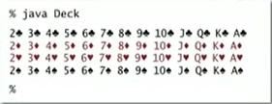

Homework assignment 1c
Given two arrays:
String[] rank = {“2”, ”3 ”, “4 ”, “5 ”, “6 ”, “7 ”, “8 ”, “9 ”, “10 ”, “J ”, “Q ”, “K ”, “A”};
String[] suit = {“♠”, “ ♡”, “♢”, “♣”};
String[] deck = new String [52];
Write Java statements, using nested for loops to put all the cards in the deck array. Then display/print the contents of the deck.
Sample Output:

Slide 28
Homework assignment 1c
How to type the symbols for suit of cards.
Shortcut alt codes for playing cards
Card Symbol | Name | Alt + Code | Alt + X
♠ | Spade Dark | 9824 | 2660
♡ | Hearts Light | 9825 | 2661
♢ | Spades Light | 9826 | 2662
♣ | Clubs Dark | 9827 | 2663
hold the alt key and type the numbers using numeric keypad

Slide 29
Homework assignments
A link will be provided for you to upload your solutions on BB.
Due date: Sunday 7 Mar 2021 @ 8pm.
Counts toward your T1 assessment mark.

Slide 30
Conclusion
Class reps ??
Next lesson: Two-dimensional Arrays
Please check BB regularly for any announcements
If you have any questions/queries please contact me via email: burgerr@cput.ac.za

